Slide 1
CONTROL FLOW

Slide 2
Control Flow
By default C# executes from top to bottom , however we can alter the flow of program execution and provide better control on the flow of execution based on Logic and values.

Slide 3
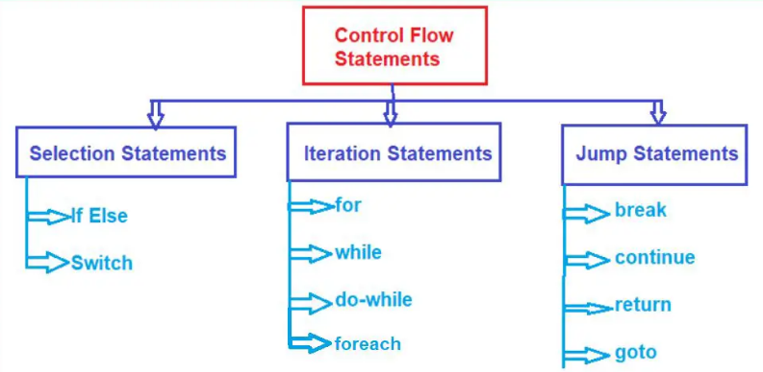

Slide 4
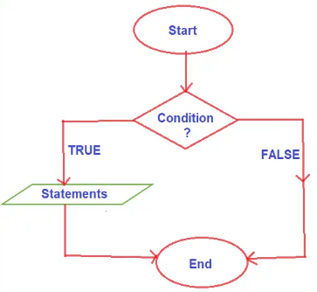
If Statements in C#
If else execute a block of statements (one or more instructions) when the condition in the if block is true and when its false it skip the execution of the if block .

Slide 5
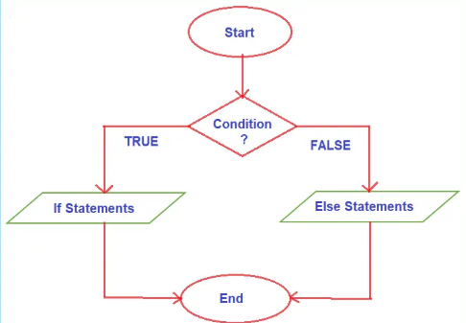
Else If Statement
When the condition is true the if block is executed and if the condition is false then the else block will execute, but only one block is executed.
For every if condition statement, the else block is optional. But for every else block, the if block is compulsory. The purpose of the ‘if’ statement in a program is to allow multiple execution paths for varying user inputs, making it more interactive!

Slide 6
Nested-If and Ladder If
When an if-else statement is present inside the body of another if or else then this is called nested if-else. Nested IF-ELSE statements are used when we want to check for a condition only when the previous dependent condition is true or false.
In Ladder if-else statements one of the statements will be executed depending upon the truth or false of the conditions. As soon as one of the conditions controlling the if is true, the statement associated with that if block is going to be executed, and the rest of the C# else-if ladder is bypassed.

Slide 7
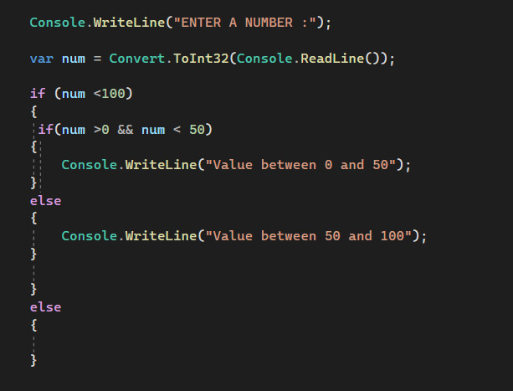
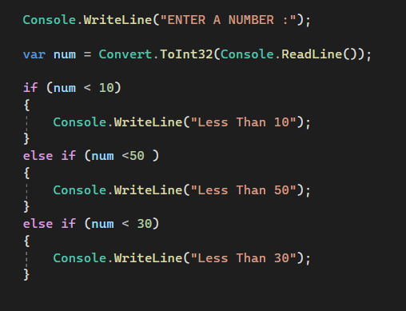

Slide 8
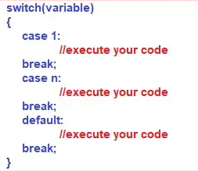
Switch
The switch is a keyword in the C# language, and by using this switch keyword we can create selection statements with multiple blocks. And the Multiple blocks can be constructed by using the case keyword.
Switch case statements in C# are a substitute for long if else statements that compare a variable or expression to several values. The switch statement is a multi-way branching statement which means it provides an easy way to switch the execution to different parts of code based on the value of the expression. Nested if makes the program more complex and less readable.

Slide 9
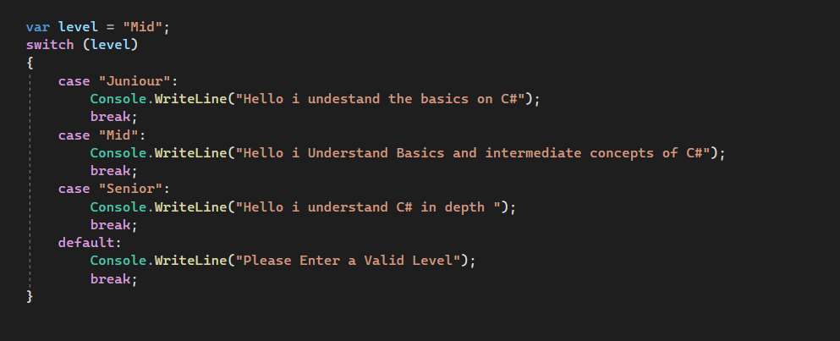

Slide 10

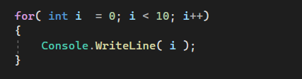
Loops in C#
Loops is the process of repeatedly executing a statement or group of statements until the condition is satisfied. When the condition becomes false the execution of the loop terminates.
The Whole intention of loops in programming is to make the code cleaner and efficient as well as make the developer job easier e.g. if you were to print numbers from 0 to 9 without a loop you will have 10 console.write statements but with loops its one .

Slide 11
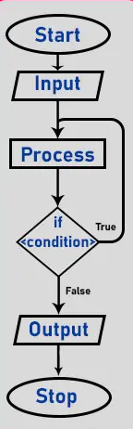
Types of Loops
For Loop
For each Loop
While loop
Do while loop

Slide 12

While Loops
A while loop is used for executing a statement repeatedly until a given condition returns false. Here, statements may be a single statement or a block of statements
While we are working with a while loop first, we need to check the condition, if the condition is true then the control will pass within the body and if the condition is false the control will pass outside the body.
While we are working with a while loop first, we need to check the condition, if the condition is true then the control will pass within the body and if the condition is false the control will pass outside the body.
While loop is an example of an entry-controlled loop because in the while loop before executing the body first condition is evaluated if the condition is true then the body will be executed otherwise the body will be skipped.

Slide 13
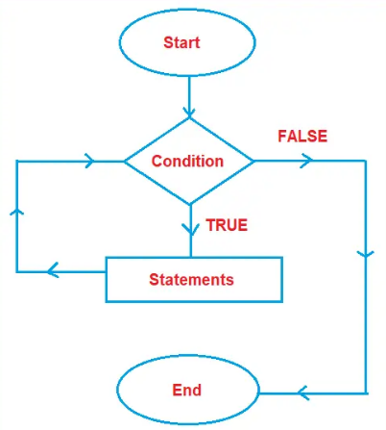

Slide 14
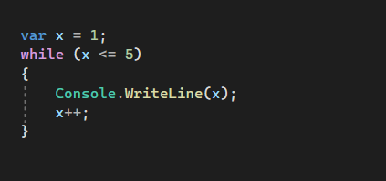

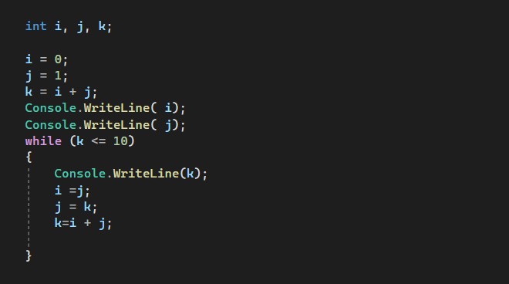


Slide 15
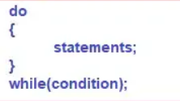
Do-While Loop
The do-while loop is a post-tested loop or exit-controlled loop i.e. first it will execute the loop body and then it will be going to test the condition. That means we need to use the do-while loop where we need to execute the loop body at least once
The difference between the do-while loop and the while loop in C# is that the do-while evaluates its test condition at the bottom of the loop whereas the while loop evaluates its test condition at the top. Therefore, the statements written inside the do-while block are executed at least once whereas we cannot give a guarantee that the statements written inside the while loop are going to be executed at least once.

Slide 16
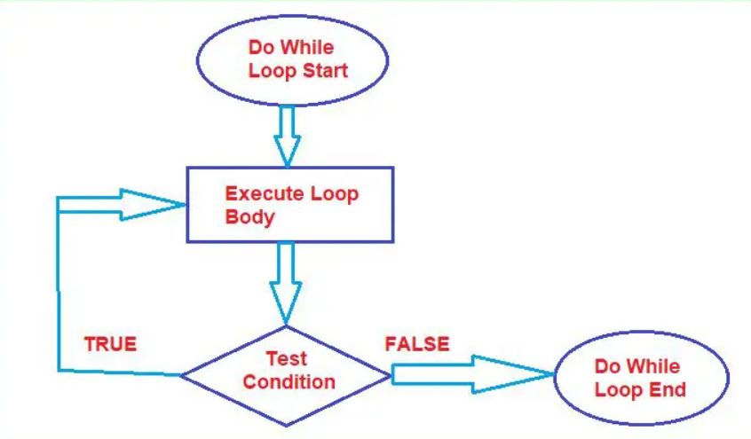

Slide 17
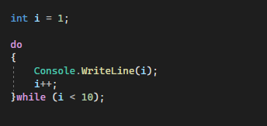

Slide 18
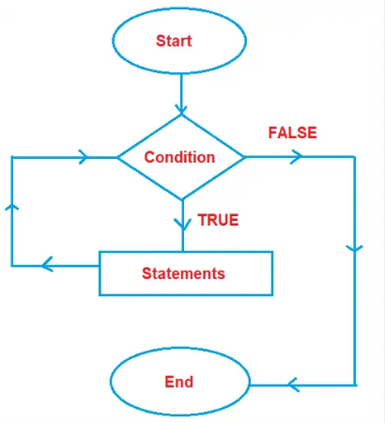
For Loop
For loop is one of the most commonly used loops in the C# language. If we know the number of times, we want to execute some set of statements or instructions, then we should use for loop. For loop is known as a Counter loop.

Slide 19
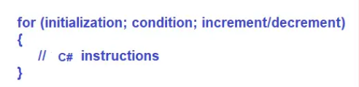
For Loop Stages
Loop initialization
Condition evaluation
Execution of instruction
Increment/Decrement
Loop Initialization: Loop initialization happens only once while executing the for loop, which means that the initialization part of for loop only executes once. Here, initialization means we need to initialize the counter variable.
Condition Evaluation: Conditions in for loop are executed for each iteration and if the condition is true, it executes the C# instruction and if the condition is false then it comes out of the loop.
Execution of Instruction: Once the condition is evaluated, and if the condition is true, then the control comes to the loop body i.e. the loop body is going to be executed.
Increment/Decrement: After executing the loop body, the increment/decrement part of the for loop will be executed, and once it executes the increment decrement part i.e. once it increments and decrements the counter variable, again it will go to the condition evaluation stage.

Slide 20
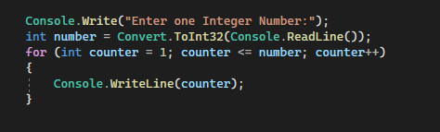
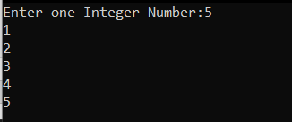
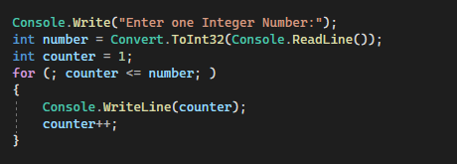
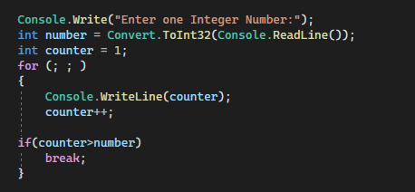

Slide 21
Jump Statements
Jump statement are used to transfer control from one point or location to another point or location. They are used to modify the behavior of conditional and iterative statements .
They include:
Break
Continue
Goto
Return
throw

Slide 22
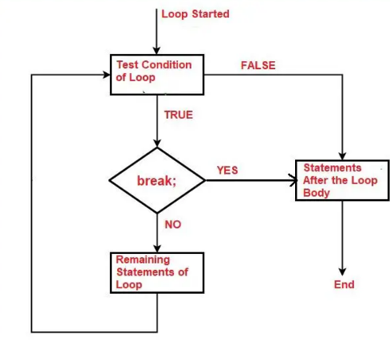
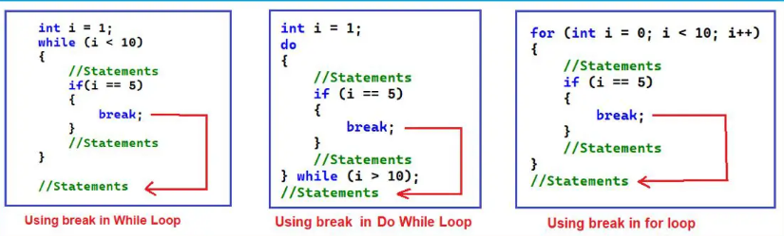
Break Statement
Break is a keyword that is used to terminate the loop body or the switch body. In a switch each case should be terminated by a break statement to terminate the switch block.

Slide 23
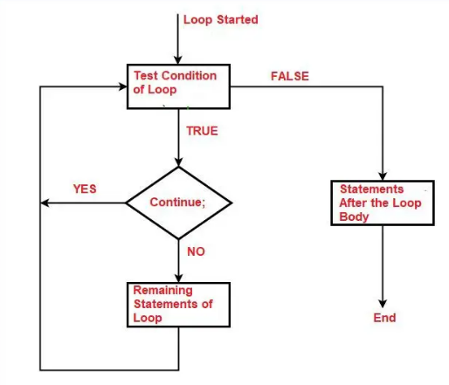
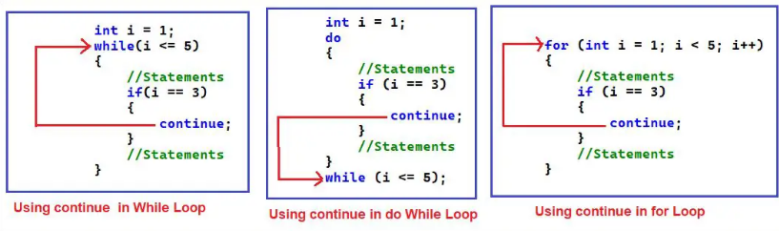
Continue Statement
Sometimes we need to skip the statement execution from the loop body and we
The BREAK statement terminates the loop, whereas the CONTINUE statement skips only the current loop iteration, and allows the next loop iteration to proceed. The continue statement is almost always used with the if…else statement need to continue the loop execution for the next iteration.

